Slide 1
Online Role-based training resources: Microsoft Learn https://docs.microsoft.com/en-us/learn/

Slide 2
M03: Cleaning, Transforming, and Loading Data
Author name Date

Slide 3
Module Agenda
Shaping the Data
Profiling the Data
Enhance the Data Structure

Slide 4
Learning Objectives
You will learn the following concepts:
Shaping the Data
Profiling the Data
Enhancing the structure of the data
Notes:
By the end of this module, you’ll be able to:
Profile the data
Shape the data
Enhance the structure of the data

Slide 5
Lesson 1: Shaping the Data

Slide 6
Learning Objectives
Benefits of clean data
More accurate results
Better organized tables
Simpler data navigation
Human-readable values

Slide 7
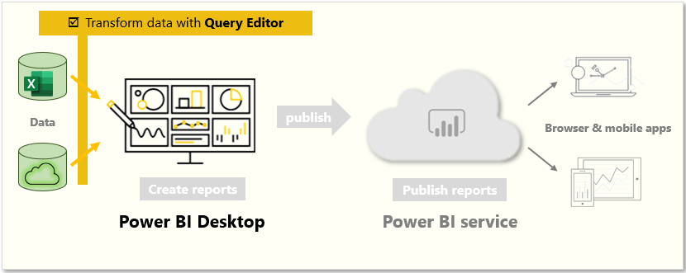
Identify column headers and names
Use Power Query Editor to clean up and shape data.
Notes:
Power Query Editor in Power BI Desktop allows you to shape (transform) your imported data. You can accomplish actions such as renaming columns or tables, changing text to numbers, removing rows, setting the first row as headers, and much more. It is important to shape your data to ensure that it meets your needs and is suitable for use in reports.
Get started with Power Query Editor
To start shaping your data, open Power Query Editor by selecting the Transform data option on the Home tab of Power BI Desktop. When you work in Power Query Editor, all steps that you take to shape your data are recorded. Then, each time the query connects to the data source, it automatically applies your steps, so your data is always shaped the way that you specified.
Identify column headers and names
The first step in shaping your initial data is to identify the column headers and names within the data and then evaluate where they are located to ensure that they are in the right place.

Slide 8
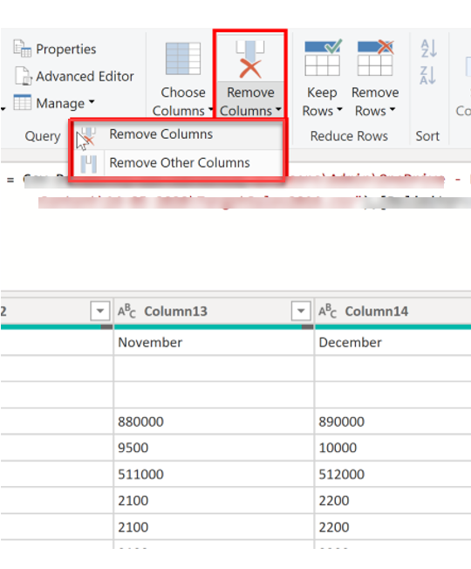
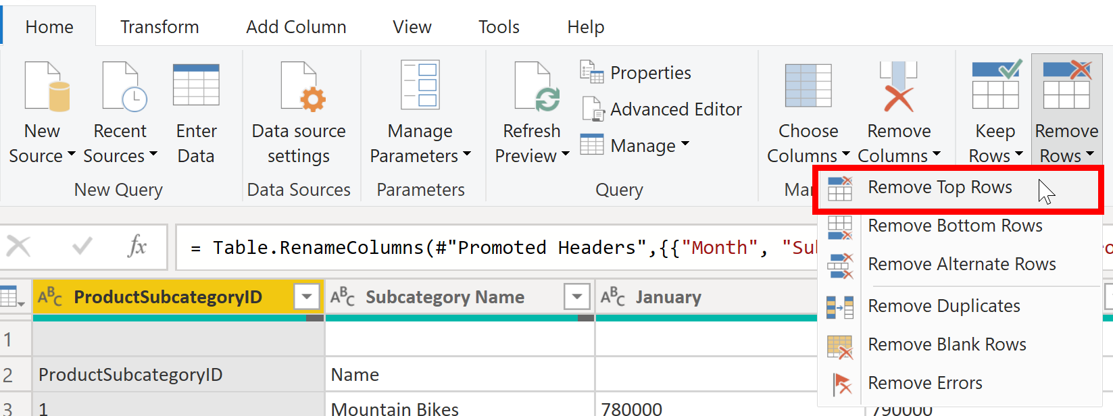
Shaping Table Structure
Shape the data to meet reporting needs.
Notes:
With Power BI Desktop, you can connect to many different types of data sources, then shape the data to meet your needs, enabling you to create visual reports to share with others. Shaping data means transforming the data: renaming columns or tables, changing text to numbers, removing rows, setting the first row as headers, and so on.
Promote headers
When a table is created in Power BI Desktop, Power Query Editor assumes that all data belongs in table rows. However, a data source might have a first row that contains column names, which is what happened in the previous SalesTarget example. To correct this inaccuracy, you need to promote the first table row into column headers.
Rename columns
The next step in shaping your data is to examine the column headers. You might discover that one or more columns have the wrong headers, a header has a spelling error, or the header naming convention is not consistent or user-friendly.
Remove top rows
When shaping your data, you might need to remove some of the top rows, for example, if they are blank or if they contain data that you do not need in your reports.
Remove columns
A key step in the data shaping process is to remove unnecessary columns. It is much better to remove columns as early as possible. Removing columns at an early stage in the process rather than later is best, especially when you have established relationships between your tables.

Slide 9
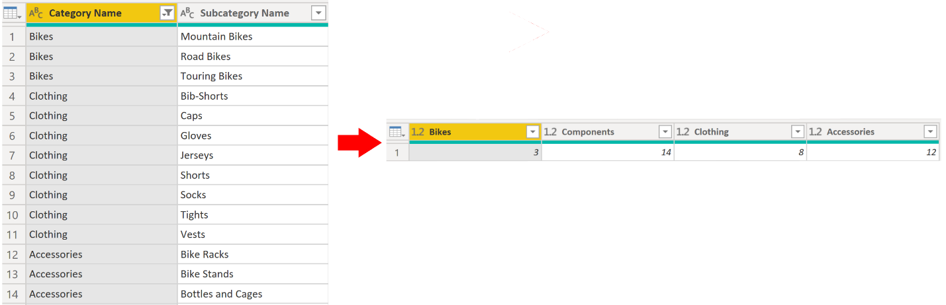
Unpivot and Pivot columns
Transfer data from rows to columns, and columns to rows.
Notes:
Unpivoting is a useful feature of Power BI. You can use this feature with data from any data source, but you would most often use it when importing data from Excel. Unpivoting streamlines the process of creating DAX measures on the data later. By completing this process.
If the data that you are shaping is flat (in other words, it has lot of detail but is not organized or grouped in any way), the lack of structure can complicate your ability to identify patterns in the data. You can use the Pivot Column feature to convert your flat data into a table that contains an aggregate value for each unique value in a column.
Pivot columns
If the data that you are shaping is flat (in other words, it has lot of detail but is not organized or grouped in any way), the lack of structure can complicate your ability to identify patterns in the data.
You can use the Pivot Column feature to convert your flat data into a table that contains an aggregate value for each unique value in a column. For example, you might want to use this feature to summarize data by using different math functions such as Count, Minimum, Maximum, Median, Average, or Sum.

Slide 10
Review Questions
Q01 – The primary data preparation tool in Power BI is called what?
A01 – Power Query Editor
Q02 – The process of shaping data by converting your flat data into a table that contains an aggregation value for each unique value in a column is called what?
A02 – Pivot (pivoting a column)
Q03 – What can be achieved by removing unnecessary rows and columns?
A03 – Deleting unnecessary rows and columns will reduce a dataset size and its good practice to load only necessary data into your data model.

Slide 11
Lesson 2: Profiling the Data

Slide 12
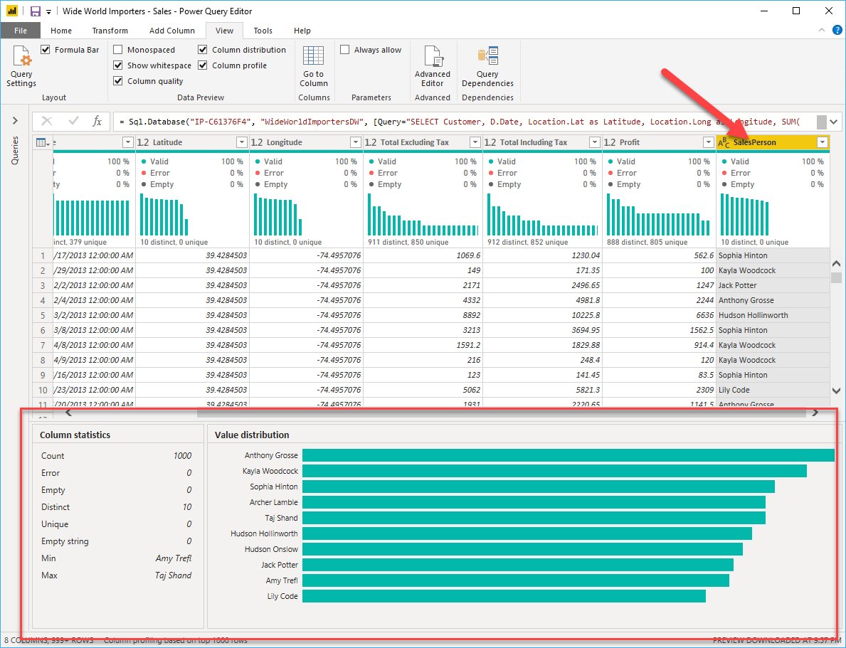
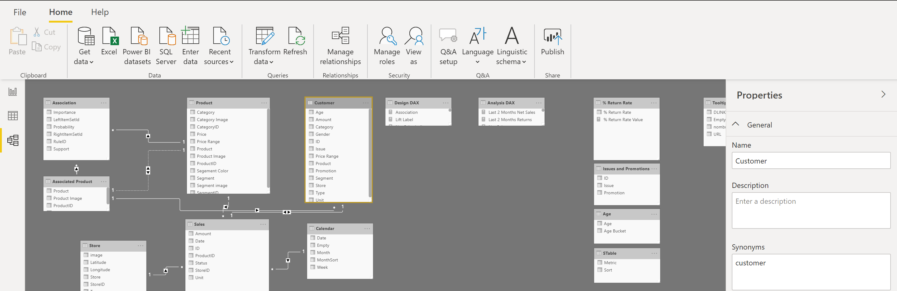
Profiling Data and Examining Structures
Data profiling is understanding the state and structure of the data you are working with.
Notes:
Profiling data is about studying the nuances of the data: determining anomalies, examining and developing the underlying data structures, and querying data statistics such as row counts, value distributions, minimum and maximum values, averages, and so on. This concept is important because it allows you to shape and organize the data so that interacting with the data and identifying the distribution of the data is uncomplicated, therefore helping to make your task of working with the data on the front end to develop report elements near effortless.
Examine data structures
Before you begin examining the data in Power Query Editor, you should first learn about the underlying data structures that data is organized in. Profiling data occurs either prior to or in parallel to data shaping.
<CLICK>
Find data anomalies and data statistics
After you have created a connection to a data source and have selected Transform Data, you are brought to Power Query Editor, where you can determine if anomalies exist within your data. Data anomalies are outliers within your data.
Column distribution shows you the distribution of the data within the column
Column profile gives you more details about the data in the column, including basic statistics.
The Value distribution graph tells you the counts for each unique value in that specific column.
Column Statistics will also include how many zeroes and null values exist, along with the average value in the column, the standard deviation of the values in the column, and how many even and odd values are in the column.

Slide 13
Review Questions
Q01 – How many rows does Power Query scan to detect the type of data in the columns?
A01 – 1000
Q02 – Data profiling is defined as what?
A02 – Studying the nuances of the data
Q03 – What is the risk of having null values in a numeric column?
A03 – DAX expressions that AVERAGE data will be incorrect.

Slide 14
Lesson 3: Enhance the Data Structure

Slide 15
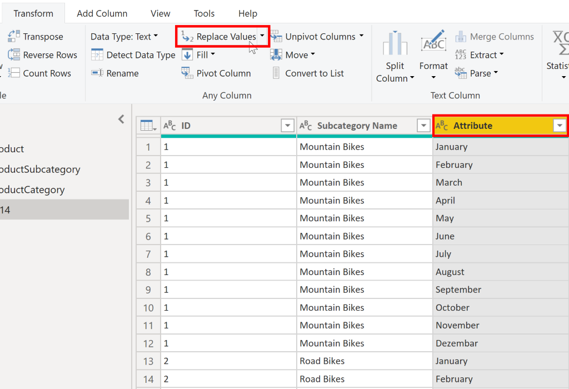
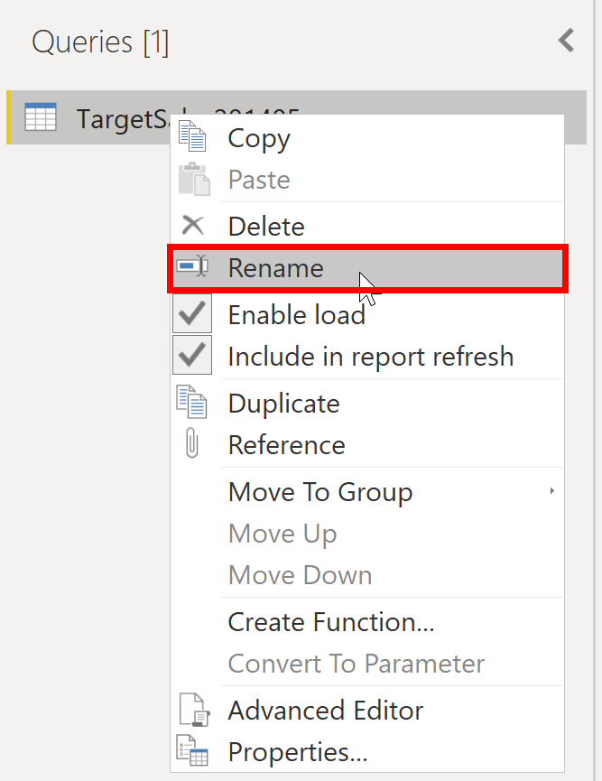
Apply user-friendly value replacements
Make information user-friendly.
Notes:
When you import data from multiple sources into Power BI Desktop, the data retains its predefined table and column names. You might want to change some of these names so that they are in a consistent format, easier to work with, and more meaningful to a user. You can use Power Query Editor in Power BI Desktop to make these name changes and simplify your data structure.
Rename a query
It's good practice to change uncommon or unhelpful query names to names that are more obvious or that the user is more familiar with.
Replace values
You can use the Replace Values feature in Power Query Editor to replace any value with another value in a selected column.
Replace null values
Occasionally, you might find that your data sources contain null values.
Remove duplicates
You can also remove duplicates from columns to only keep unique names in a selected column.
Best practices for naming tables, columns, and values
A best practice is to give your tables, columns, and measures descriptive business terms and replace underscores ("_") with spaces. Be consistent with abbreviations, prefaces, and words like "number" and "ID." Excessively short abbreviations can cause confusion if they are not commonly used within the organization.

Slide 16
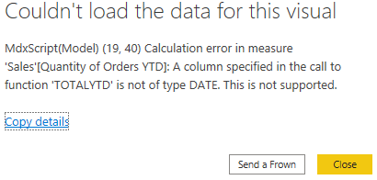
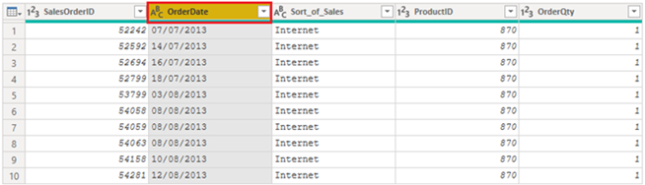
Evaluate and Change Column Data Types
Notes:
When you import a table from any data source, Power BI Desktop automatically starts scanning the first 1,000 rows (default setting) and tries to detect the type of data in the columns. Some situations might occur where Power BI Desktop does not detect the correct data type. Where incorrect data types occur, you will experience performance issues.
A best practice is to evaluate the column data types in Power Query Editor before you load the data into a Power BI data model. If you determine that a data type is incorrect, you can change it. You might also want to apply a format to the values in a column and change the summarization default for a column.
Implications of incorrect data types
Incorrect data types will prevent you from creating certain calculations, deriving hierarchies, or creating proper relationships with other tables.
<CLICK>
For example, if you try to calculate the Quantity of Orders YTD, you will get the following error stating that the OrderDate column data type is not Date, which is required in time-based calculations.
Change the column data type
You can change the data type of a column in two places: in Power Query Editor and in the Power BI Desktop Report view by using the column tools. It is best to change the data type in the Power Query Editor before you load the data.
As with any other changes that you make in Power Query Editor, the change that you make to the column data type is saved as a programmed step. This step is called Changed Type and it will be iterated every time the data is refreshed.

Slide 17
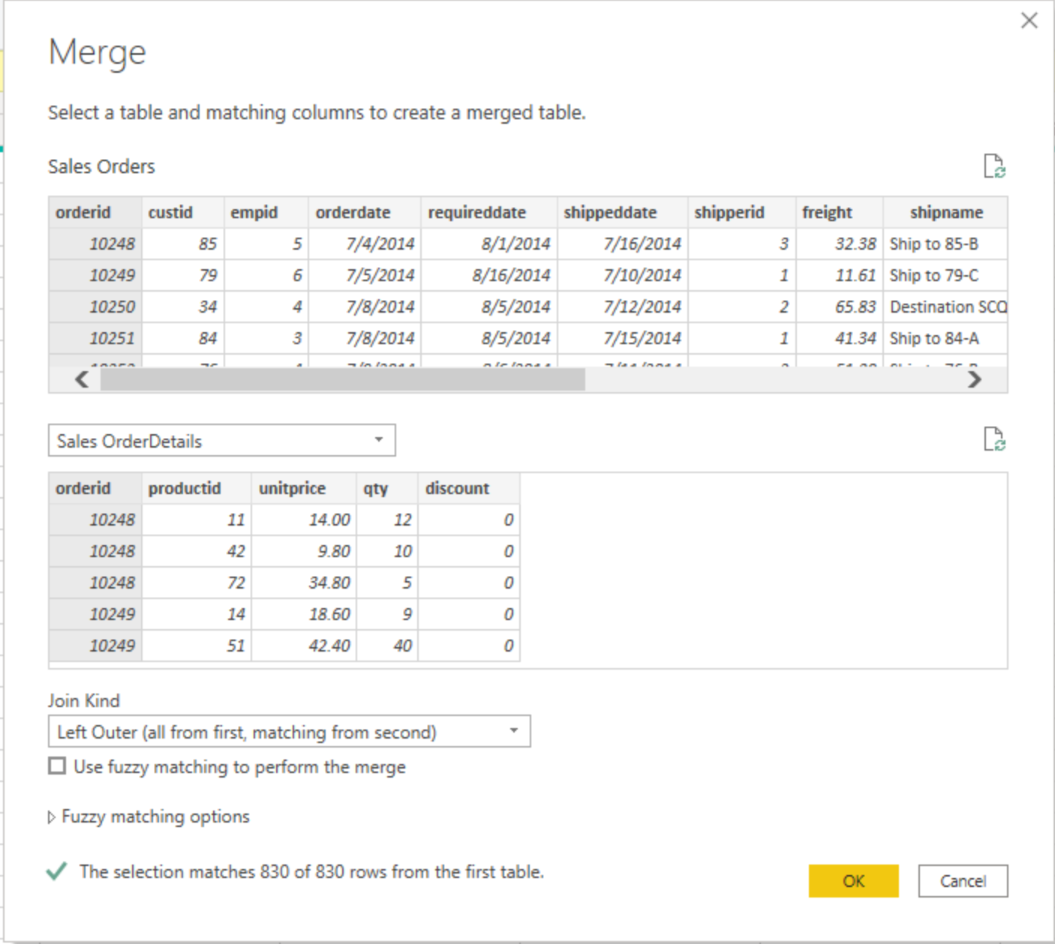
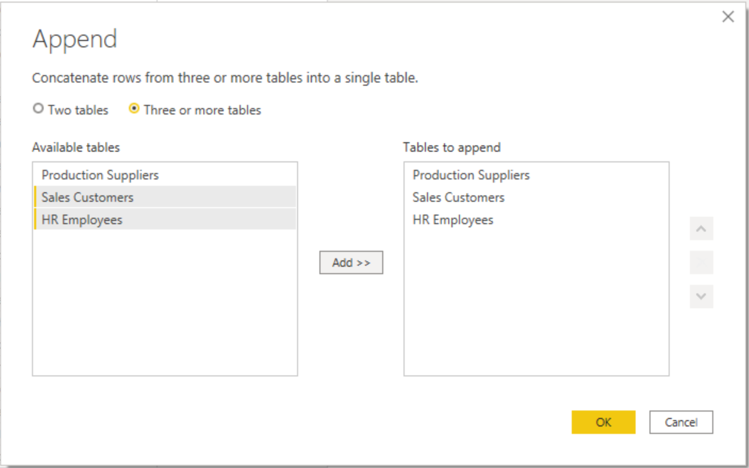
Combine Multiple Tables into a Single Table
Notes:
The ability to combine queries is powerful because it allows you to append or merge different tables or queries together. You can combine tables into a single table in the following circumstances:
Too many tables exist, making it difficult to navigate an overly-complicated data model.
Several tables have a similar role.
A table has only a column or two that can fit into a different table.
You want to use several columns from different tables in a custom column.
You can combine the tables in two different ways: merging and appending.
Append queries
When you append queries, you will be adding rows of data to another table or query.
Merge queries
When you merge queries, you are combining the data from multiple tables into one based on a column that is common between the tables. This process is similar to the JOIN clause in SQL.

Slide 18
Review Questions
Q01 – What is not a best practice for naming conventions in Power BI?
A01 – Abbreviated column names
Q02 – If you have two queries that contain different data with the same structure, and you want to combine them into one query, which operation should you perform?
A02 - Append

Slide 19
Lab: Load Data in Power BI Desktop
Lab: Load Data in Power BI Desktop

Slide 20
Module Overview
We covered the following concepts:
Profiling the Data
Shaping the Data
Enhancing the structure of the data
Notes:
In this module we discussed:
How to profile the data
How to shape data
How to enhance the structure of the data

Slide 21

References
PL-300 Clean, transform, and load data in Power BI
https://docs.microsoft.com/en-us/learn/modules/clean-data-power-bi/

Slide 22
Closing slide

